Slide 1
1
Problem 1: In a buck-boost converter, consider all components to be ideal. Let input voltage V_{d} be 10~35V, output voltage V_{o}=15V (regulated), f_{s}=20kHz, L=0.2 mH and output capacitor C is sufficient large .
(a) Calculate the minimum P_{o} that will keep the converter operating in a continuous-conduction mode at all range of V_{d} .
(b) What will happen if we keep D constant and load R is open？
i_{d}
i_{D}
+
V_{d}
-
D
+
v_{L}
-
-
V_{o}
+
i_{L}
C
R
L
i_{o}

Slide 2
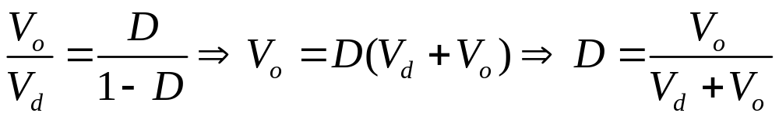
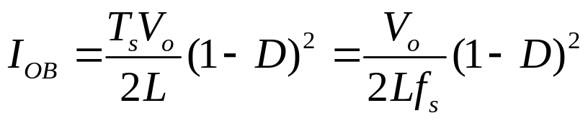
Solution 1
(a)
As the range of V_{d} is 10~35V, so the range of D is 0.3~0.6.
As
As V_{d} = 10V, D=0.6, I_{OB} =0.3A, P_{OB} =4.5W,
And V_{d} = 35V, D=0.3, I_{OB} =0.918A, P_{OB} =13.78W,
P_{OMIN} =13.78W,
So the minimum P_{o} is 13.78W that will keep the converter operating in a continuous-conduction mode.

Slide 3
Solution 1
If we keep D constant and the load R is open，the energy stored in C can’t be discharged and will be accumulated, then the power Switches will be destroyed.
(b)
i_{d}
i_{D}
+
V_{d}
-
D
+
v_{L}
-
-
V_{o}
+
i_{L}
C
R
L
i_{o}

Slide 4
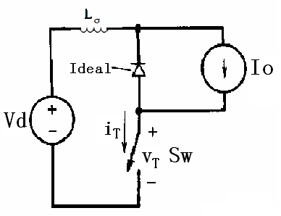
2
(2013). A step-down converter is shown in Figure (1), if the diode is ideal, please draw the waveforms (v_{T},i_{T}) of switching device (Sw), and tell us the total power losses on Sw include , , .
Figure (1)
If V_{d}=300V, I_{o}=100A, and switching frequency of Sw is 20kHz, which type of power diodes you should choose in this converter (Line-frequency rectifier diodes, Fast-recovery diodes, Schottky diodes)?

Slide 5
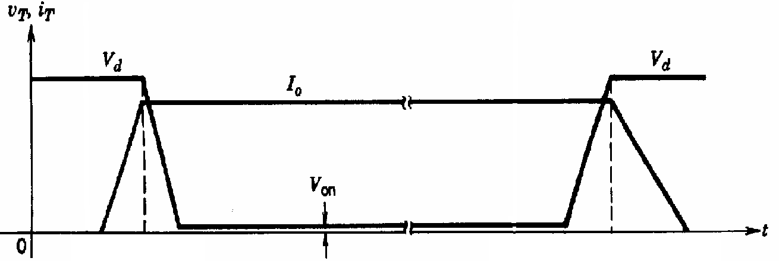
解：
Figure (1)
通态损耗、开关过程损耗、断态损耗
快恢复二极管

Slide 6

2. Please draw a buck-boost converter, and explain the operation principle of this converter, write down the relationship between V_{in} and V_{o}.
i_{d}
i_{D}
解：
+
V_{d}
-
D
+
v_{L}
-
-
V_{o}
+
i_{L}
C
R
L
工作原理：
开关管闭合，二极管承受反压关断，电源电压给电感蓄能，电感电流上升；开关打开，二极管导通给电感电流续流，电感存储的能量释放给负载，电感电流下降。
i_{o}

Slide 7
3. In a boost converter, V_{in}=12V, V_{o}=24V, I_{o}=1A, Δi_{L}=1A, and f_{s}=10kHz. Assuming ideal components, draw the waveforms of v_{L}, i_{L}, i_{T}, i_{D}. If I_{o}=0(output load is disconnected),what will happen?
解：
i
L
L
D
i
D
+
+
V
-
L
i
+
s
V
V
C
R
o
d
-
-

Slide 8
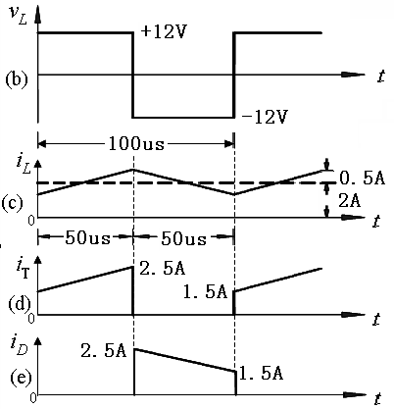
解： 假定电路工作在连续状态，则：V_{o}/V_{in}=1/(1-D)得：D=0.5 t_{on}=t_{off}=50us
由I_{o}/I_{in}=1-D得：I_{L}=I_{in}=2A≥ Δi_{L}/2=0.5A，电路工作在连续状态。
若负载开路，则电感存储的能量不断给电容充电，形成过压，导致电容或器件过压击穿。

Slide 9
4. In a buck converter, consider all elements to be ideal. Let V_{o}=5V be held constant, P_{o}=5~100W, V_{in}=10~15V and f_{s}=50kHz. Please calculate the minimum value of L
to keep the converter operate in a continuous conduction mode. If the output voltage ripple ΔV_{o} (peak to peak) is less than 1%, please calculate the minimum value of C in this buck converter.
解：
i_{d}
i_{o}
+
V_{d}
-
+
v_{oi}
-
L
+
v_{o}=V_{o}
-
+ v_{L} -
(a)
R
C

Slide 10
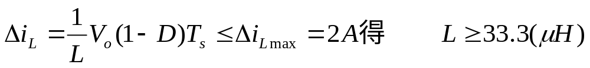
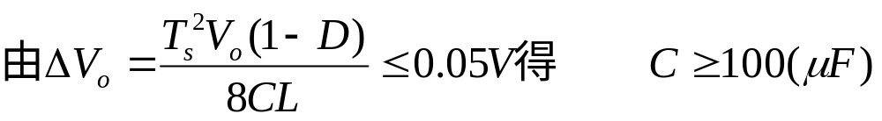
解：由f_{s}=50kHz得，T_{s}=20us
电路工作在连续状态，则由
V_{o}=DV_{in}得：1/3<D<1/2
由P_{omin}=5W得：I_{Lmin}=1A Δi_{Lmax}=2A
故电感值应选择33.3μH
故电容值应选择100μF

Slide 11
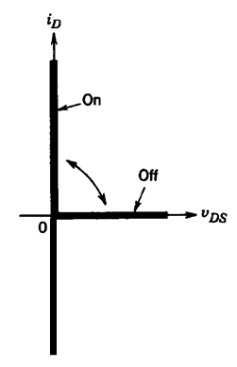
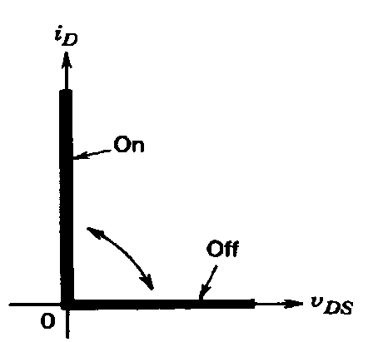
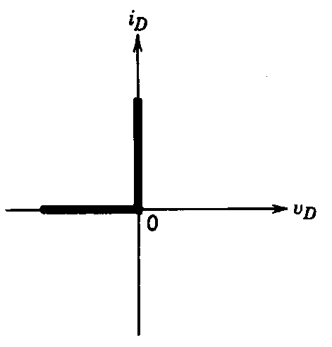
3
1 Draw the ideal characteristics of current and voltage under the practical operation condition for devices of (I) A diode (II) A MOSFET (III) An IGBT with the parallel diode, respectively.
Solution:
a)
(a)
(b)
Diode
MOSFET
MOSFET: either (a) or (b) is correct. The ideal characteristics of IGBT with the parallel diode is same as the MOSFET

Slide 12
2 In a step-down (buck) converter, consider all components to be ideal. Let v_{o}=V_{o} be held constant at 5V by controlling the switch duty ratio D. If V_{d} is 10~40V, P_{o}>=5W, and f_{s}=50kHz. a) Calculate the minimum inductance L required to keep the converter operation in a continuous-conduction mode under all conditions. b) If the output voltage ripple is limited in 1%, for the L calculated in (a), how to choose the capacitance C?
i_{d}
i_{L}
i_{o}
L
+
V_{d}
-
+
v_{oi}
-
+
v_{o}=V_{o}
-
+ v_{L} -
R
C

Slide 13
Solution:
The duty ratio is lowest when：
V_{d}=40V, I_{o} = P_{o}/V_{o} = 5 W/5 V = 1 A, T_{s}=20 μ s.
D = 5/40 = 0.125
For continuous conduction mode from Eq. 7-5,
I_{o} ≥ D(V_{d}-V_{o}) / 2f_{s}L
L_{min} = 43.75 μ H
b) ∆V_{o} = T_{s}² V_{o} (1-D) / (8CL) ≤ 5 ×0.01=0.05 V
C ≥ T_{s}² V_{o} (1-D) / (0.05 × 8 × L) = 100 μ F

Slide 14
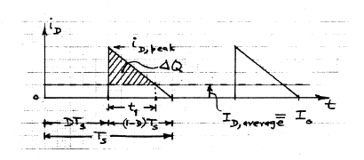
3 In a step-up (boost) converter, consider all components to be ideal. Let V_{d} = 12 V, V_{o} = 24 V(regulated), I_{o} = 0.5 A, L = 150 μH, f_{s} = 20 kHz, and C = 470 μF. Calculate ∆V_{o}(peak to peak). If a real capacitor is used in the converter, how ought you to estimate the ∆V_{o}(peak to peak)?
Solution:
Firstly, assume the converter is in CCM. For 24/12 = 1/(1-D), so D=0.5. T_{s} = 50 μ s. From Eq.7-29, I_{oB}=T_{s}V_{o}D(1-D)^2/2L=0.5A, So it’s in
boundary case.

Slide 15
Solution:
Firstly, assume the converter is in CCM. For 24/12 = 1/(1-D), so D=0.5. T_{s} = 50 μ s. From Eq.7-29, I_{oB}=T_{s}V_{o}D(1-D)^2/2L=0.5A, So it’s in boundary case.
Figure
It can be seen from the figure
i_{D,peak} = i_{L,peak} = V_{d}DT_{s}/L=12*0.5*50/150=2A
(i_{D,peak}-I_{o})/i_{D,peak}=t₁ / [(1-D)T_{s}], so t₁=18.75 μ s
∆V_{o}= ∆Q/C=0.5*t₁*(i_{D,peak}-I_{o})/C = 29.92mV

Slide 16
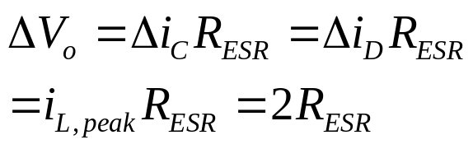
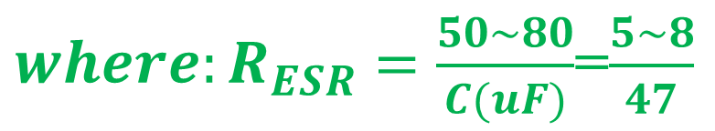
Solution:
If the R_{ESR} is considered, then ΔVo is mainly dependent of R_{ESR}.
TQ note: it‘s better if equation of RESR is figured out here

Slide 17
4 Please draw the diagram of the buck-boost converter, explain the operation principle of the converter, draw the voltage and current waveform of the inductor, and derive the relations between the output voltage and input voltage.(only consider the continuous-conduction mode)

Slide 18
i_{d}
i_{D}
Solution: figure of converter
+
V_{d}
-
D
+
v_{L}
-
i_{L}
-
V_{o}
+
Turning on the switch, V_{L}=V_{d}, and i_{L} linearly ramps up, increasing the enery in the inductor.
turning off the switch results in the inductor current flowing through the diode, some of the stored energy is transferred to the output stage, V_{L}=-V_{o}.
Operation principle
Figure of the v_{L} and i_{L}
L
C
R
i_{o}
v_{L}
V_{d}
t
(b)
(-V_{o})
T_{s}
i_{L}
I_{L}=(I_{d}+I_{o})
(c)
0
t
t_{on}
t_{off}
i_{d}
(d)
t
0
i_{D}
(e)
t
0

Slide 19
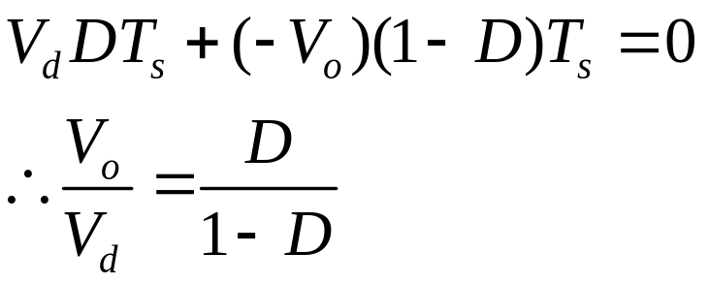
i_{d}
i_{D}
Solution:
Considering “Volt-seconds over T equal zero”
+
V_{d}
-
D
+
v_{L}
-
i_{L}
-
V_{o}
+
L
C
R
i_{o}
v_{L}
V_{d}
t
(b)
(-V_{o})
T_{s}
i_{L}
I_{L}=(I_{d}+I_{o})
(c)
0
t
t_{on}
t_{off}
i_{d}
(d)
t
0
i_{D}
(e)
t
0

Slide 20
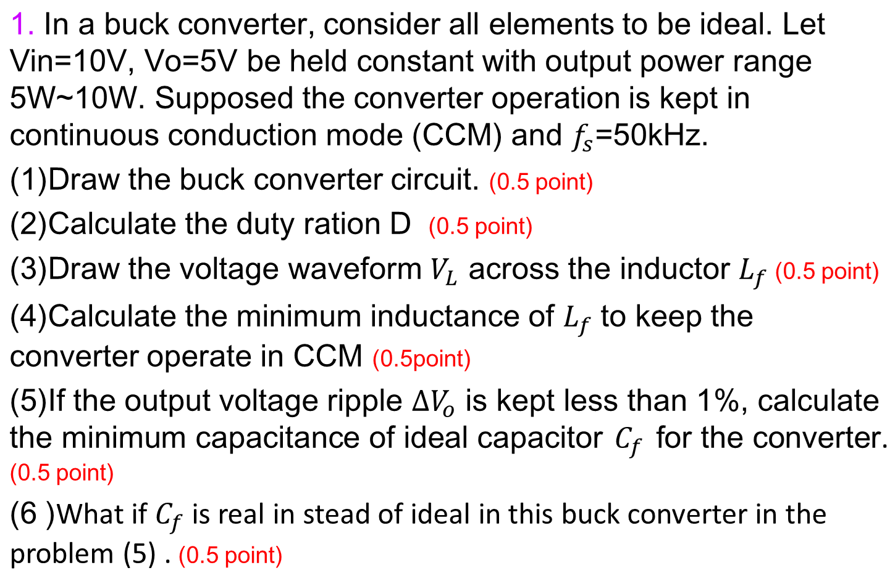
4

Slide 21
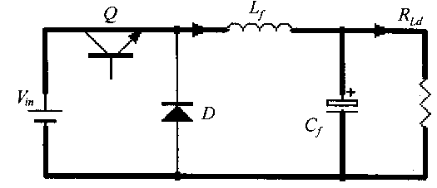
(1)Draw the buck converter circuit.
Fig.1 Buck converter circuit
(2)Calculate the duty ration D (0.5 point)
Because the circuit works in CCM, so
(3)
5V
10uS
10uS
-5V

Slide 22
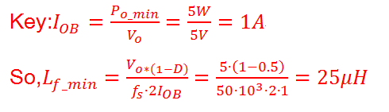
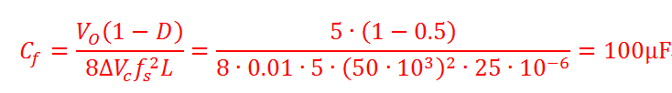
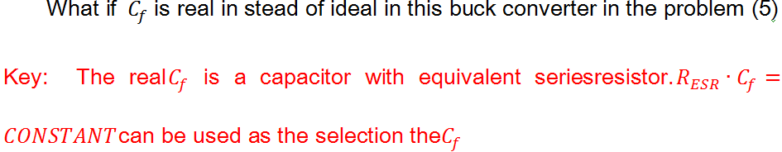
(4)
(5)
(6)

Slide 23
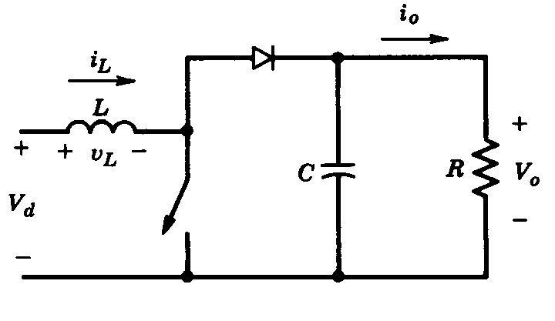
2. Please answer the following questions about Boost converter shown in Fig.1.
(1) What kinds of semiconductor device can be used as the switch? Write down the device name (all you knew) and draw its electrical symbol.
(2) If the circuit works at CCM, Vd=50V, the duty ratio of the control signal for switch is D=1/3. Calculate the voltage stress for switch and diode.
(3) If the output of this converter is open, i.e. load R is disconnected from the output port, can the boost converter work without output voltage detection for close loop control ? Why?
Fig. 1 Boost converter

Slide 24
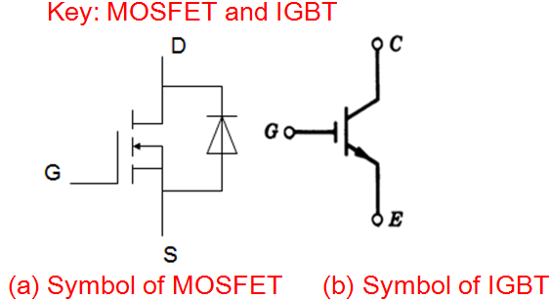
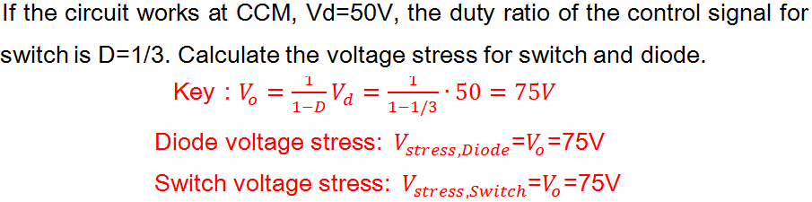
(1)
(2)

Slide 25
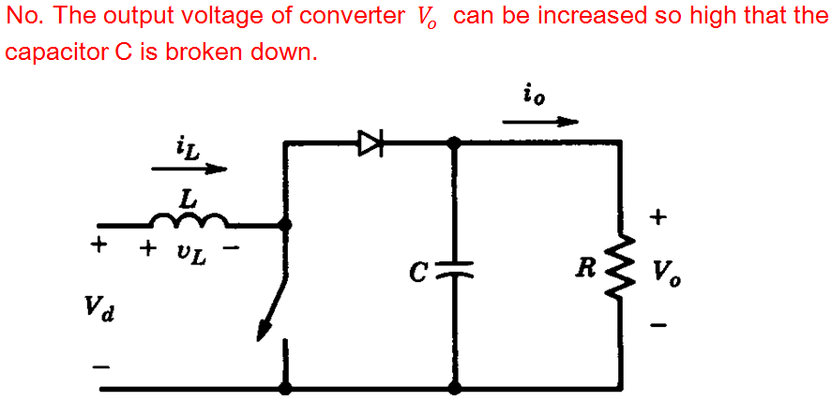
(3)

Slide 26
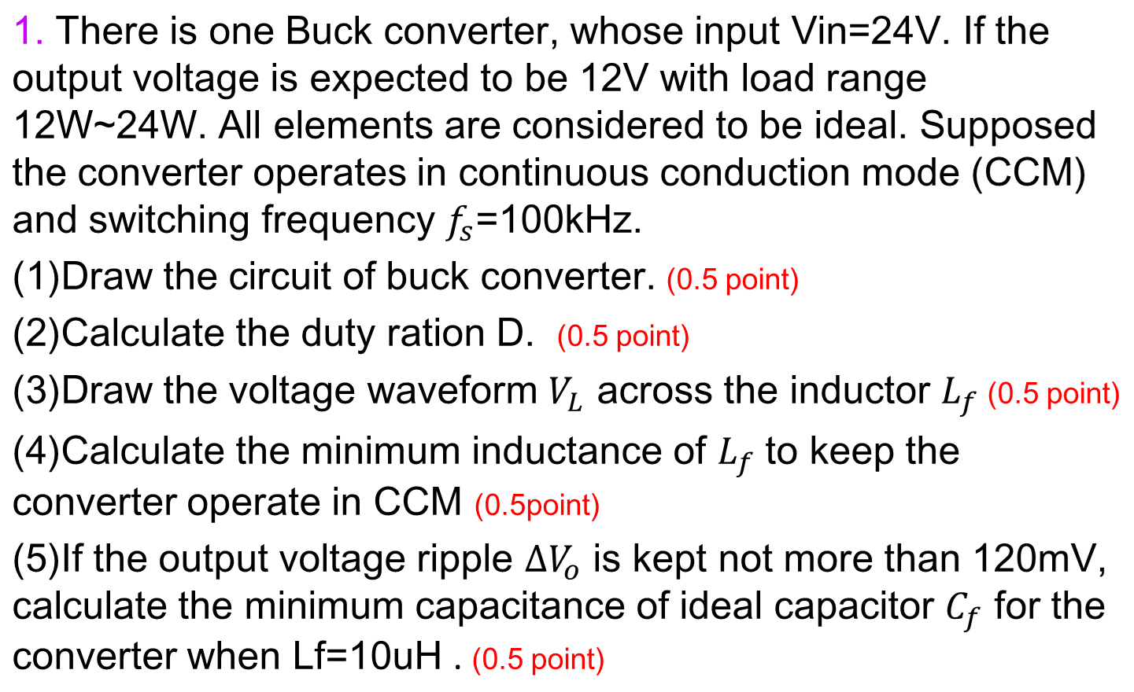
5

Slide 27
2. Please answer the following questions about Boost converter shown in Fig.1. Input voltage Vd ranges from 300V to 400V, output voltage Vo=800V, output power Po=1600W, switching frequency fs=10kHz.
(1) If the circuit works at CCM, please calculate the duty ratio of the control signal for switch. What is the voltage stress of switch and diode.
(2) According to the characteristic of PE devices, select the most suitable semiconductor device (switch and diode), which can be used in this converter? Please explain why you select that device.
(3) To keep the converter always
in CCM, calculate the minimum
inductance Lmin in the converter
Fig. 1 Boost converter

Slide 28
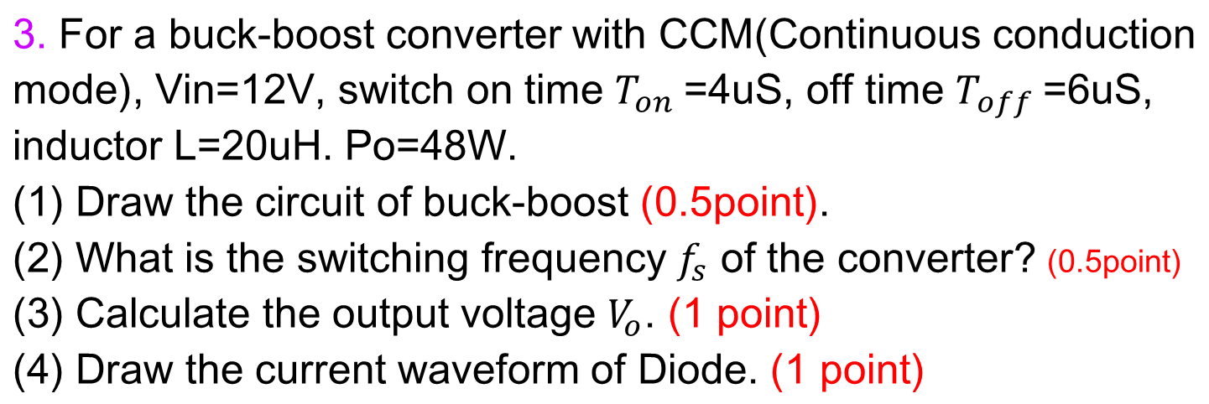

Slide 29
